Slide 1
Wallace-Hobbs section 7.2 Forces
ATM 651
fall 2023

Slide 2
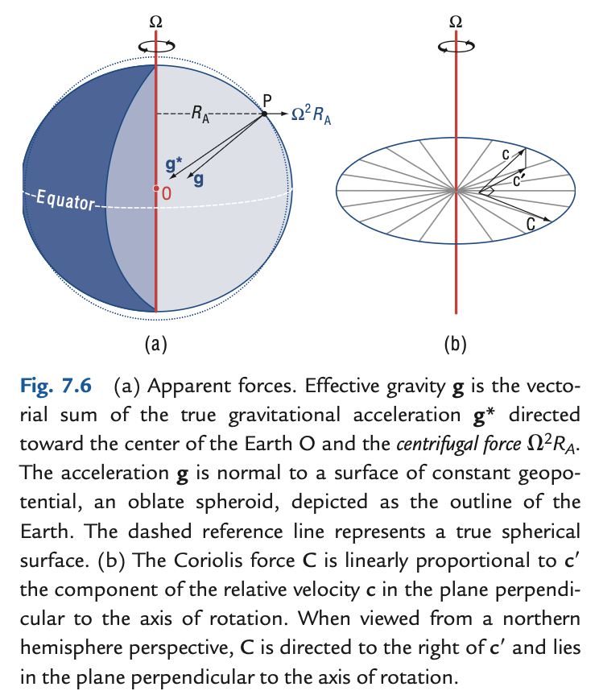
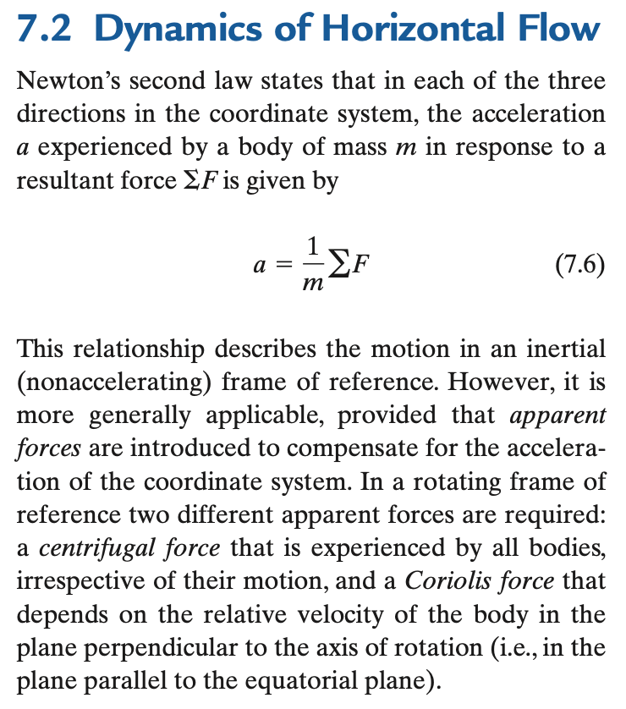
Dynamics (more causal than kinematics, still deterministic or mechanistic)

Slide 3
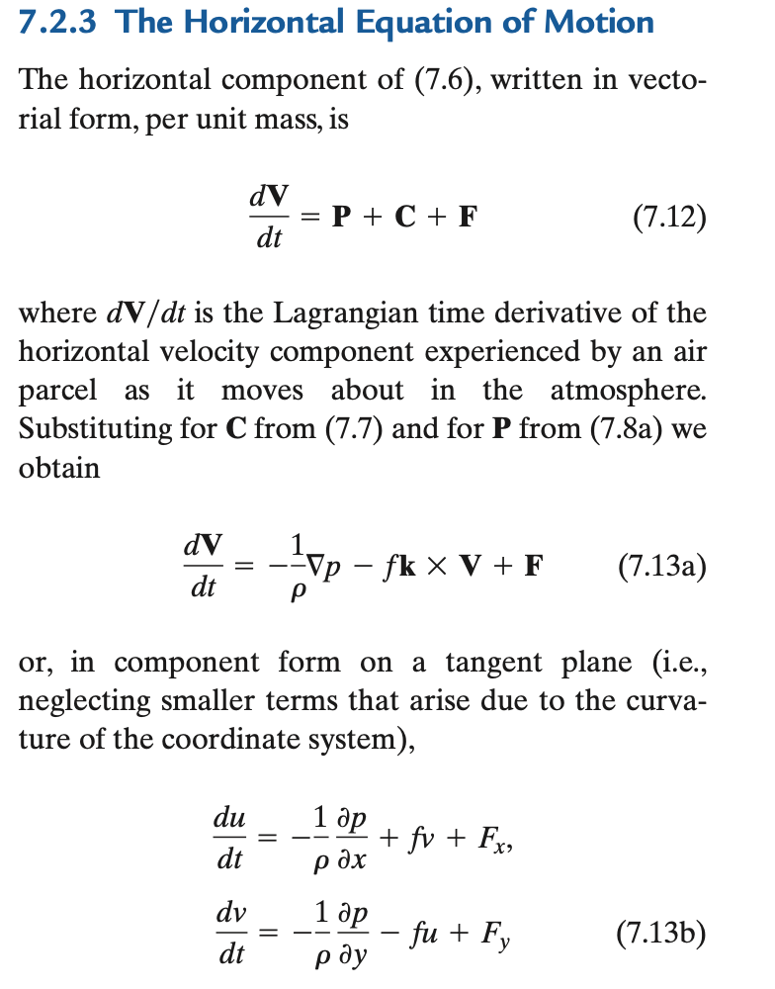
momentum equation
3 equations in 3D
Vertical is so different: hydrostatic
p holds up air against gravity
αdp/dz = -g
α = 1/ρ
”specific volume”
oceanographer: what is “volume flux”?
Horizontal is Chapter 7: vector form

Slide 4
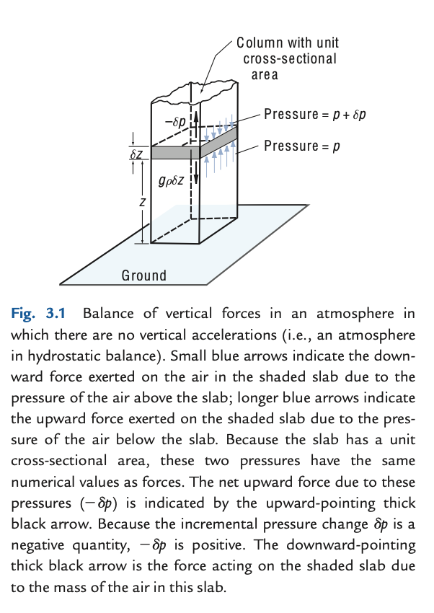
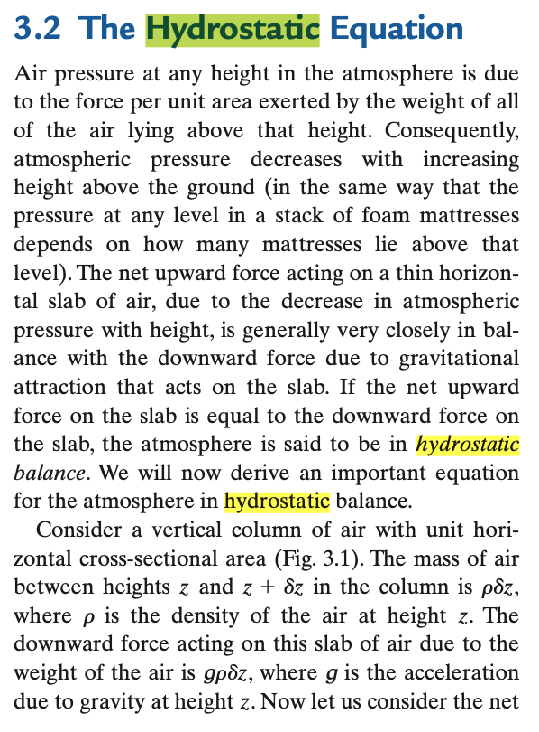
Read this on your own (part of WH ch 3)

Slide 5
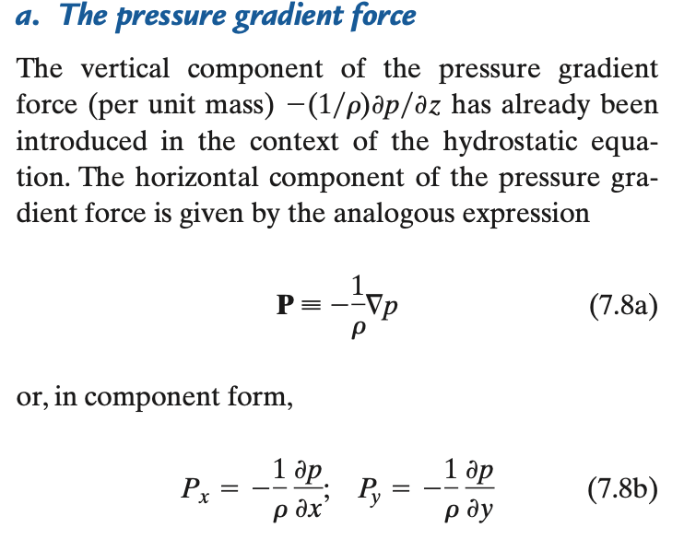
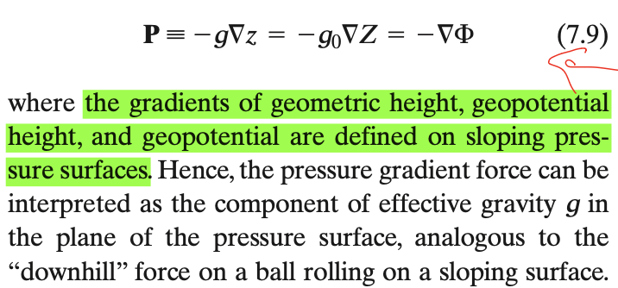
The PGF
Momentum flux convergence (flux in – flux out of box)
recalling that pressure is a flux of momentum, units (kg m/s) m⁻² s⁻¹
think ping pong ball gun knocking over plywood (but omnidirectional)
recall that p is not “given” except in undergrad spoon-feeding: it adjusts
p is the field whose PGF has a divergence that balances all other force divergences

Slide 6
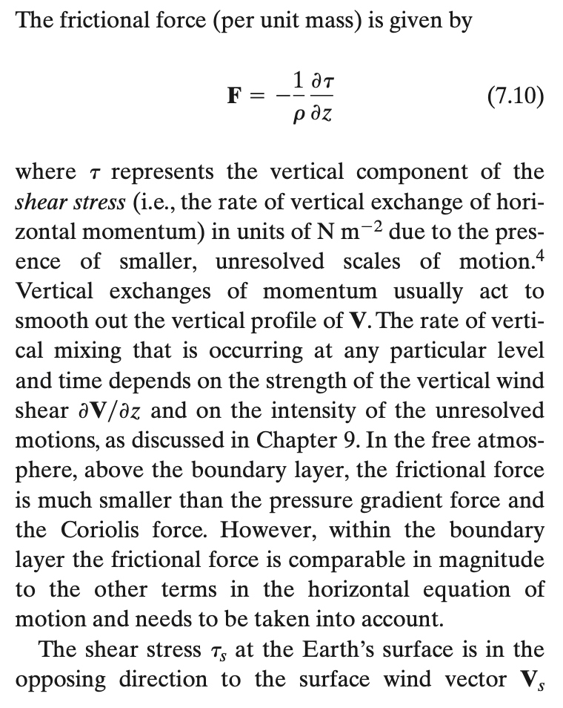
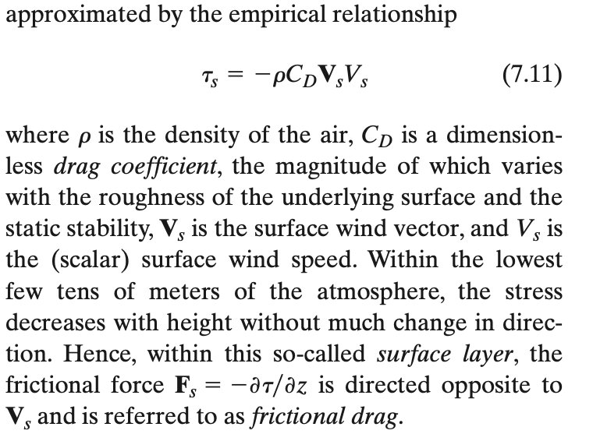
←Note: convergence of a flux!

Slide 7
The concept of “inertial forces”
“Forces” really means per unit mass (accelerations)
Like the “force” of gravity is an acceleration g (9.8 m/s/s or N/kg)
What is an inertial ”force” (or acceleration)?
(Wikipedia) Inertia is the propensity for continuation of an object in its current motion. The term is properly understood as shorthand for "the principle of inertia" as described by Newton in his first law of motion.

Slide 8
The concept of “inertial forces”
If dV/dt = 0, motion could be called “inertial”, but RHS has terms
On Earth, unit vectors are rotating in dV/dt. →Coriolis force COR ←from wind
∂V/∂t = advection of V (← from wind, classic “inertial”) + COR + PGF + Fric…
Friction too depends on wind… a “damping”… ←from wind

Slide 9
On “dynamics”: budgets, balances, and causality
Dynamics means the science of change (structure in time), right?
Kinematics was mere description (grammar, vocabulary)
Budgets are the right shape:
rate of change of (something) = source-sink + transport
Source-sink may include several terms (forces, for momentum)
Whick of these are driving (forcing) vs. damping?
mom. budget of a car: engine, transmission, brakes
bike: legs, chain, hills and air resistance, brakes – chain is just rigid links

Slide 10
A viscerally clear “budget”
Bank balance B, income I, spending S
dB/dt = I – S
Case 1: salaried professional
Case 2: rideshare driver
Case 3: lucky tech entrepreneur
Case 4: retiree

Slide 11

Ready to look at momentum equation for air (pressure coordinate in vertical)
$\partial_t (\vec V) = - \vec V \cdot \nabla_p \vec V +f \vec V \times \hat k - \nabla_p \Phi$
tderiV = HADV + COR + PGF + F
Start killing terms, making subsets we can grok
Ultimate goal: driving? transmission? brakes?
Meantime, illuminating special cases:
“balances” (geostrophic and gradient)
“inertia circles”
“ooze”
…

Slide 12
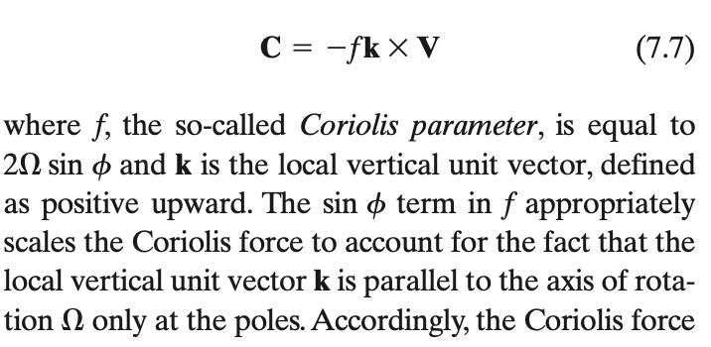
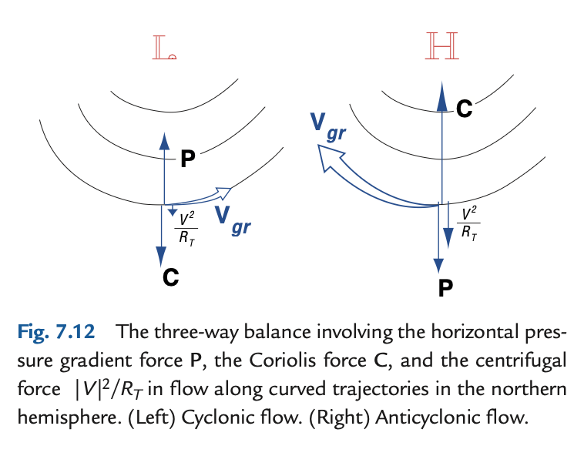

Coriolis and “centrifugal” forces
−(V.∇) V
advection of vector momentum V
2Ω x V , strictly (in 3D)

Slide 13

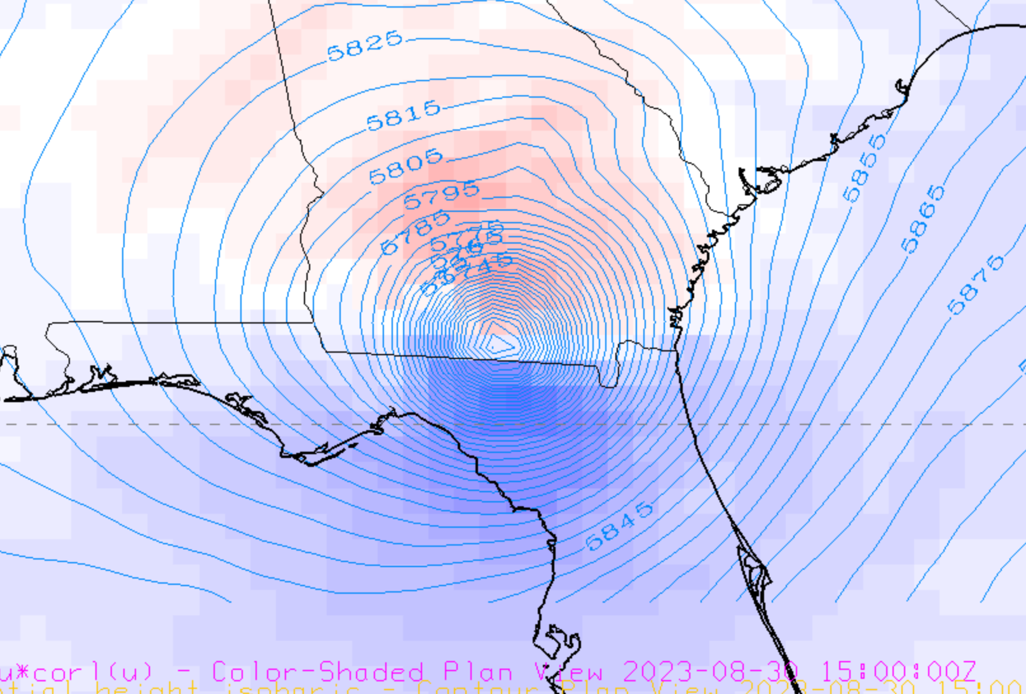
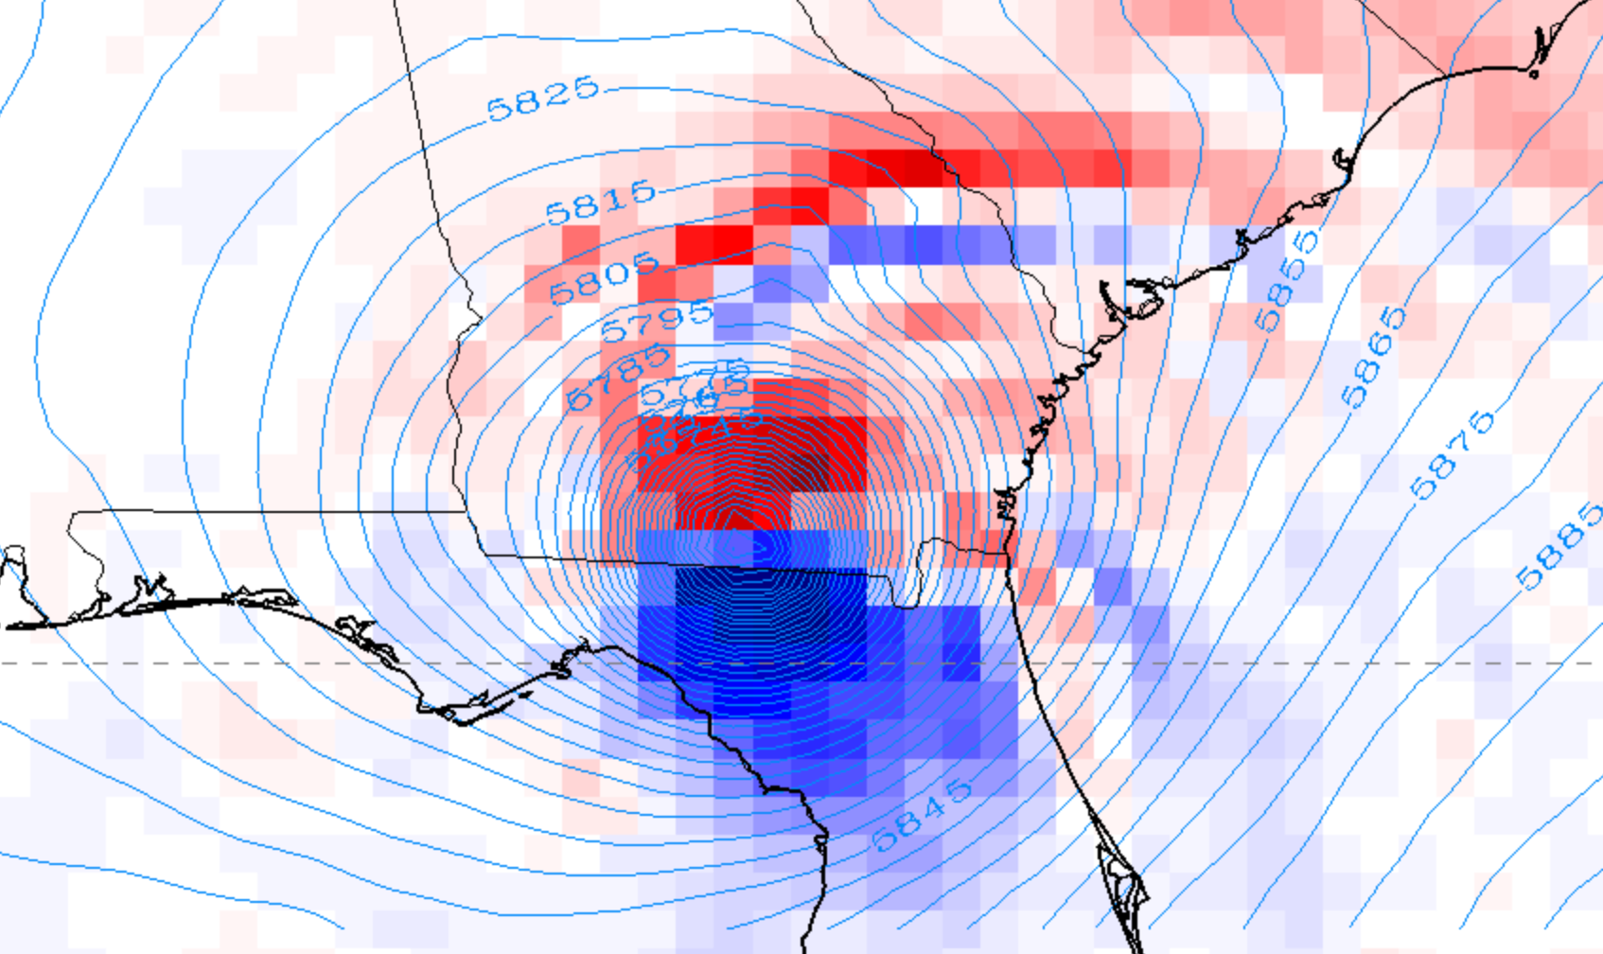
Coriolis and “centrifugal” forces
−(V.∇) V
advection of vector momentum V
(which term?)
fraction of g
2Ω x V , strictly (in 3D)
500mb

Slide 14
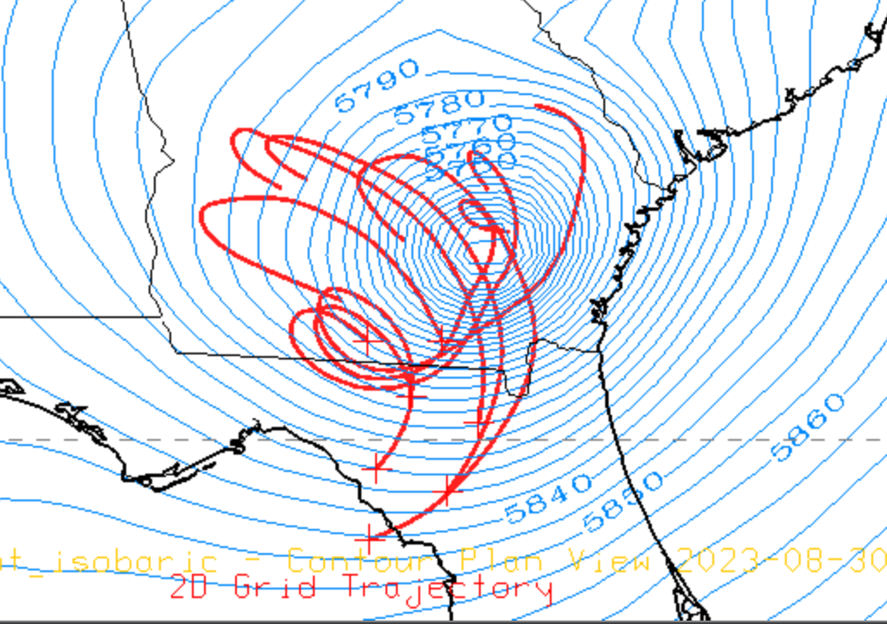
Trajectories vs. streamlines in the V²/R_{traj} framing of the “centrifugal force”
You don’t need to know the future of the whole flow to compute the inertial acceleration
Trajectories may have tiny small-R loops, even though never in the strong inner PGF, and also never at a tiny total windspeed V
Not a reliable guide to the true term −(V.∇) V
storm track

Slide 15
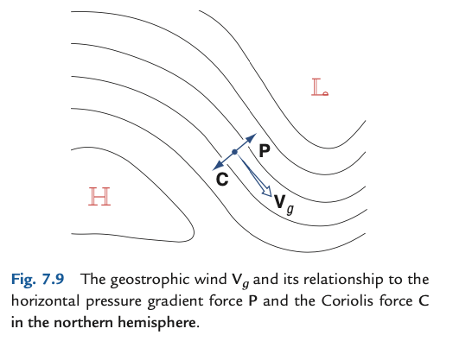
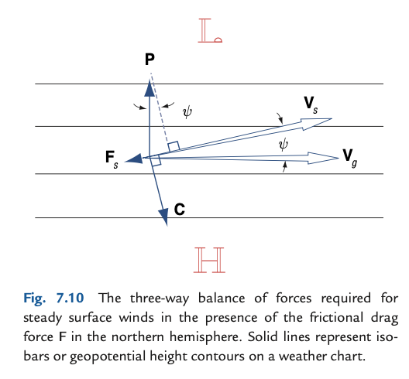
Balances

Slide 16
Balances
“Gradient wind”

Slide 17
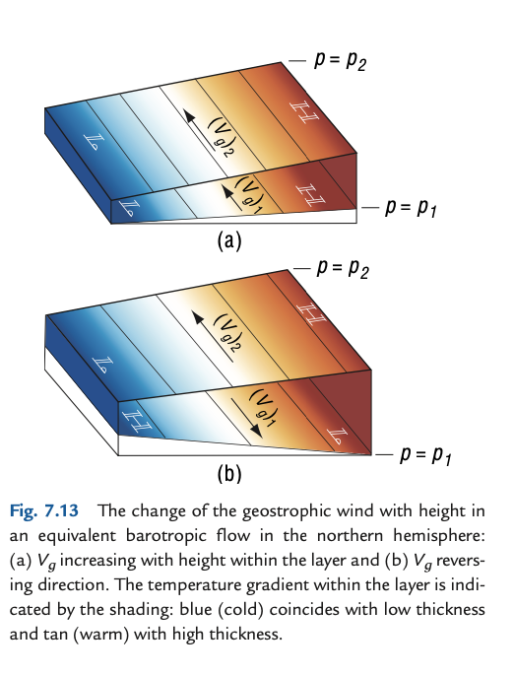
Study “thermal wind” – tricky, key compound concept

Slide 18
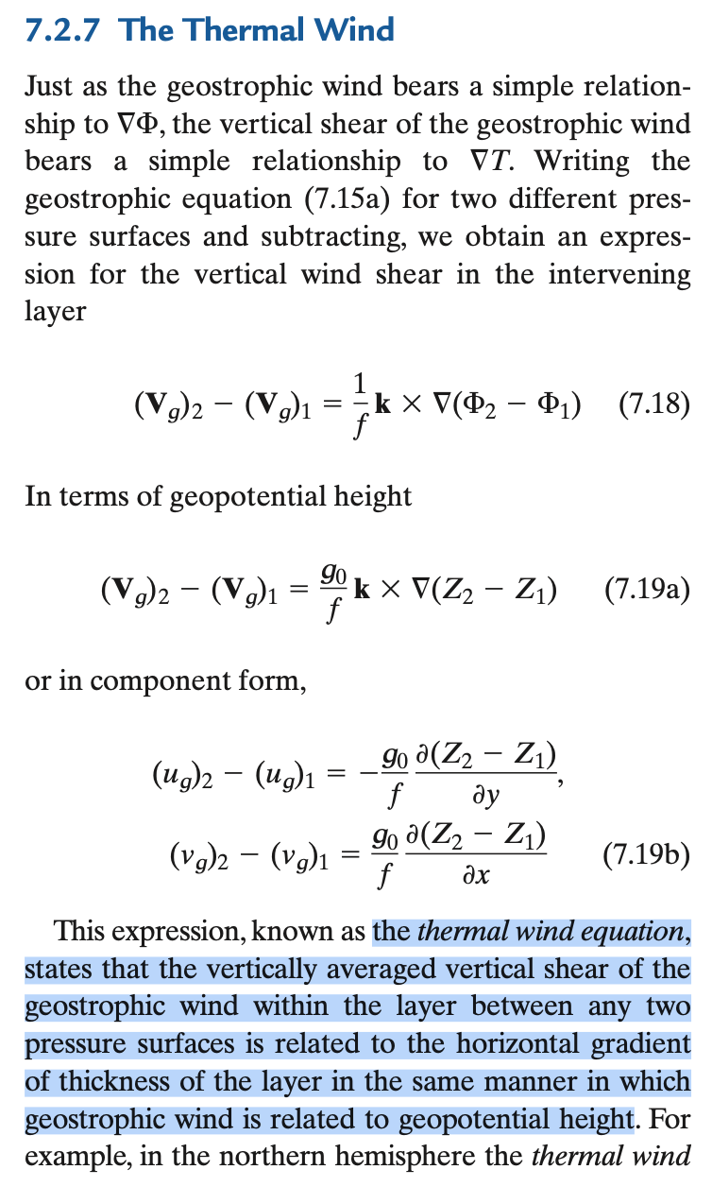
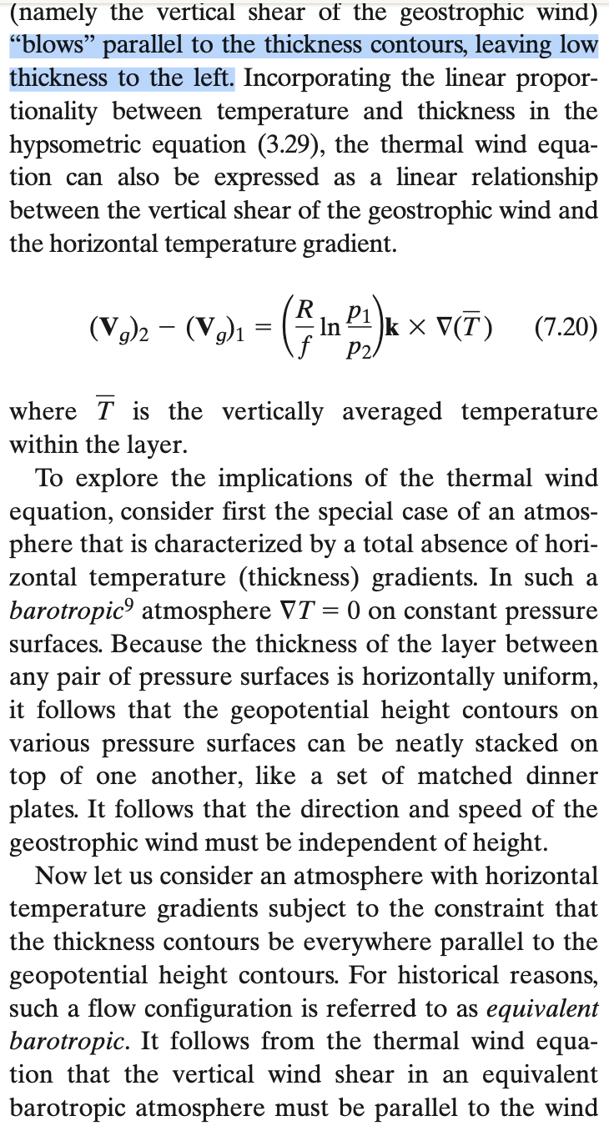

Slide 19
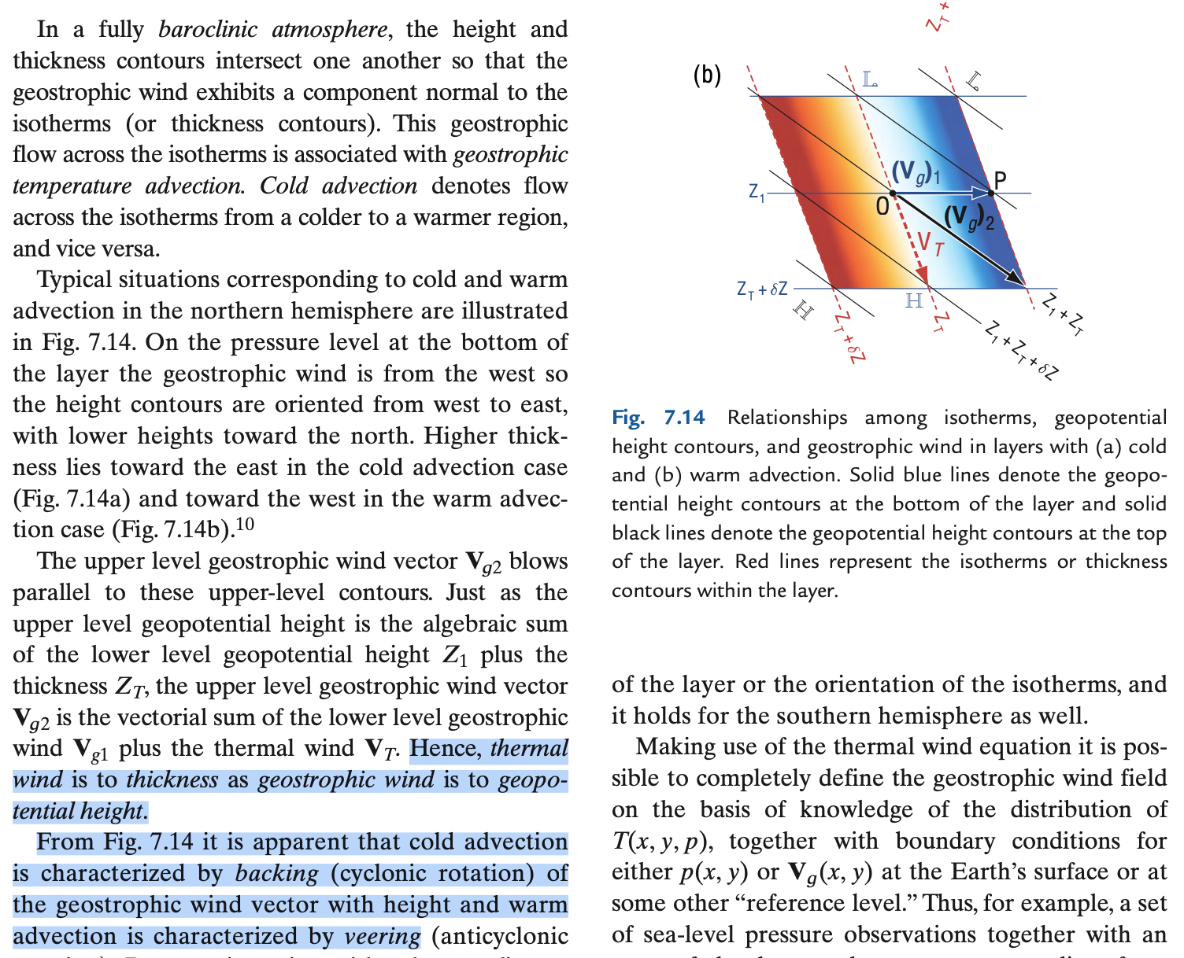
Turning of balanced wind direction indicates thickness (T) advection thermal wind itself cannot advect T (parallel to isotherms)

Slide 20
momentum equation (p coordinate in vertical)
tderiV = HADV + VADV + COR + PGF + F
Start killing terms, making subsets we can grok
tderiv small for “pattern changes slow compared to f”
HADV small for smooth patters (weak gradient of u & u)
VADV small for weak vertical motions (stratified, thin atm.)
Fric small far above PBL
COR small if rotation of Earth is slow rel. to other terms
Rotational part of a Helmholtz decomposition: make PGF vanish with curl operation.
The Vorticity Equation!

Slide 21
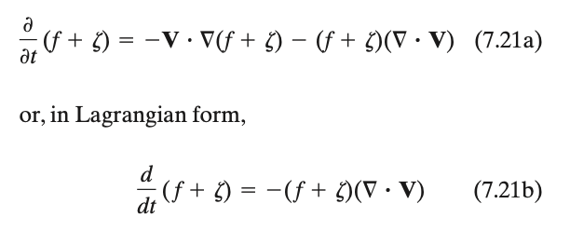
Relative vorticity ζ
Planetary vorticity f (new name for “Coriolis Parameter”!)
Absolute vorticity (ζ+f)

Slide 22
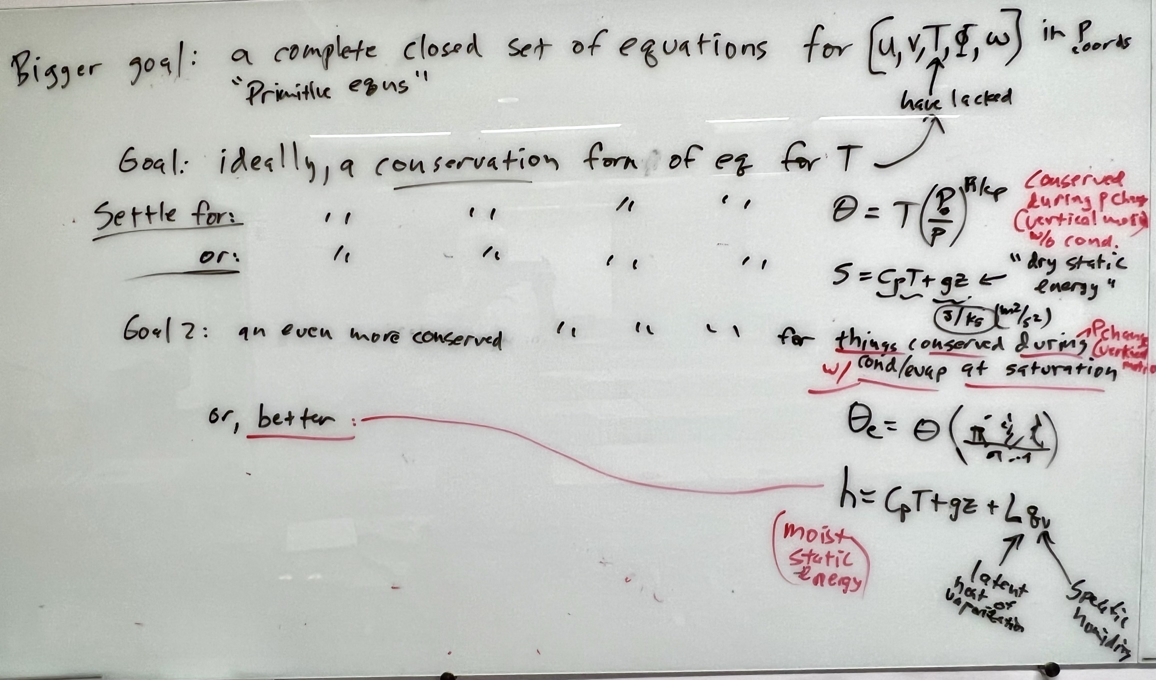

Slide 23
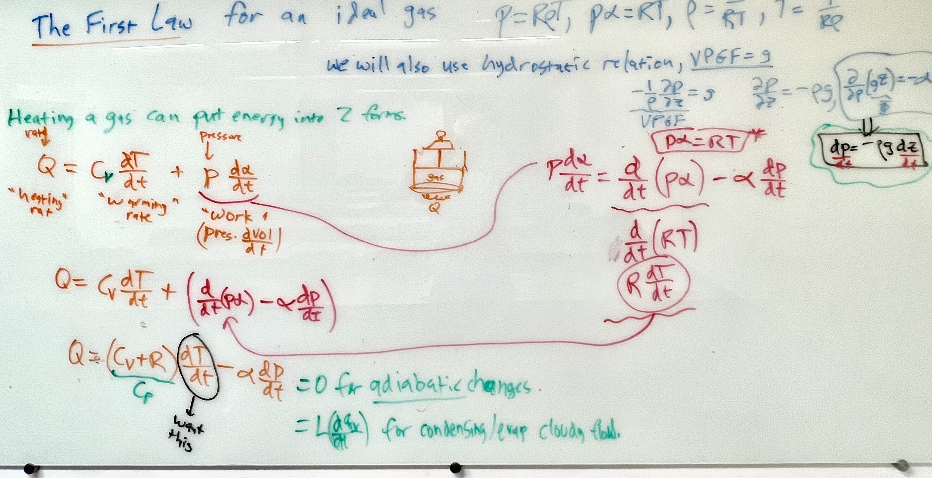

Slide 24
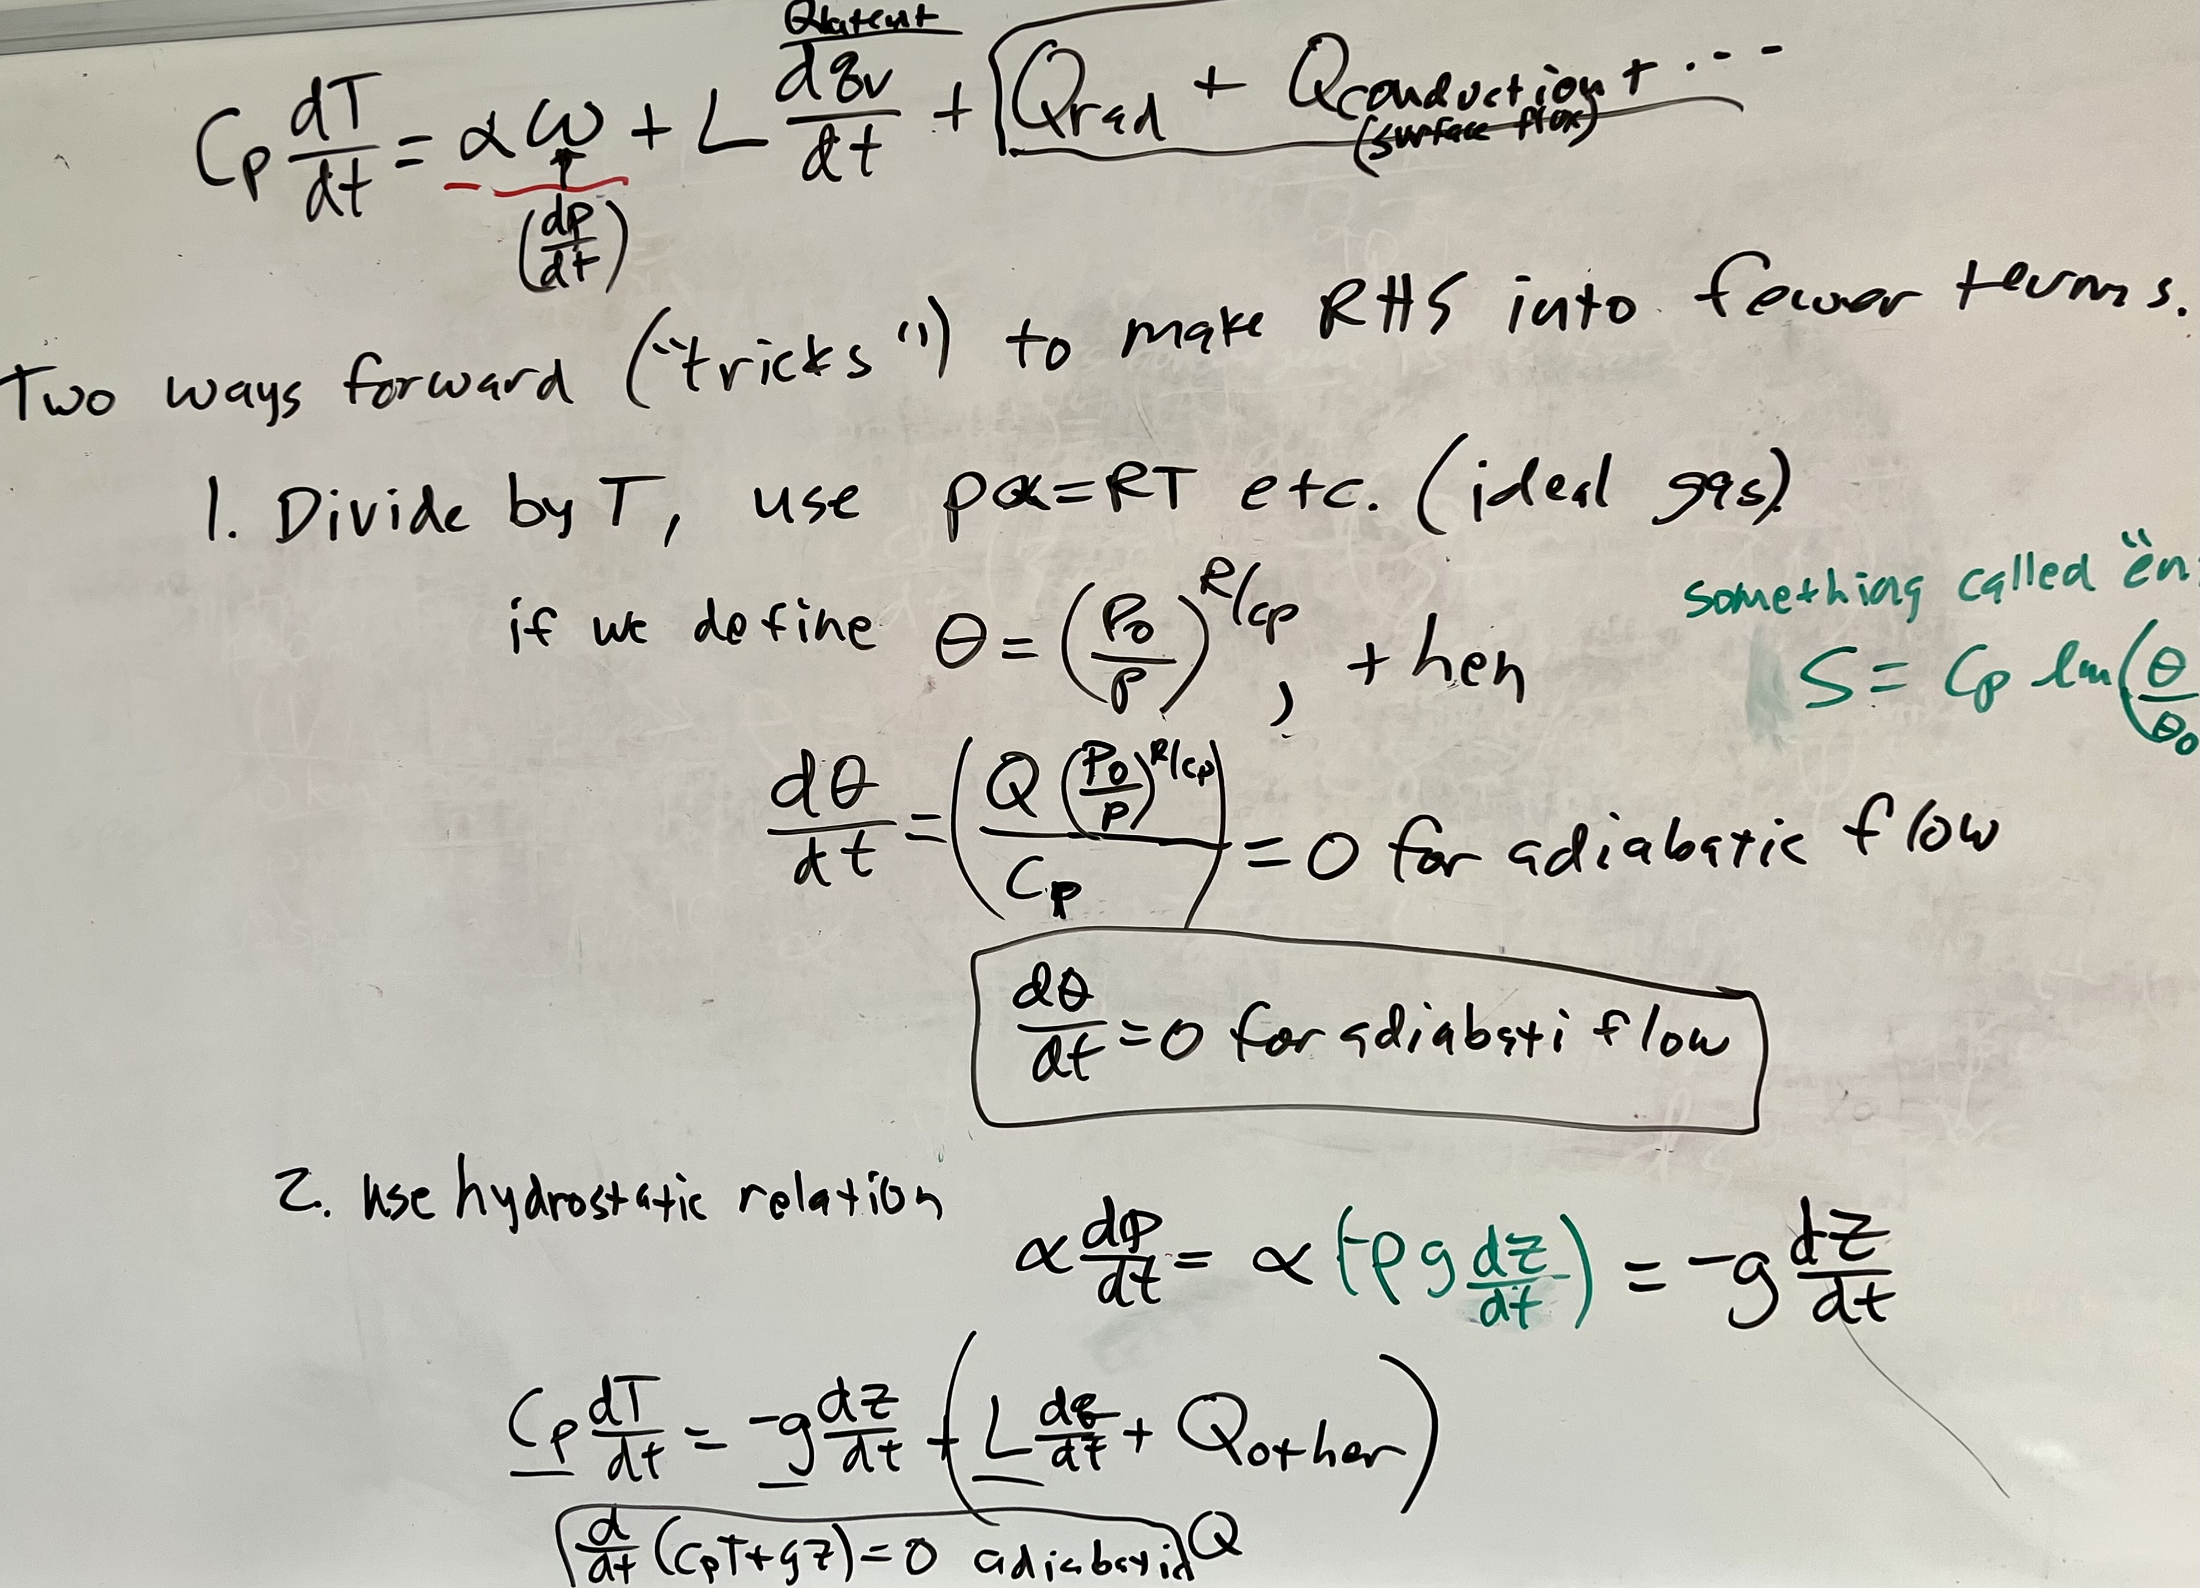

Slide 25
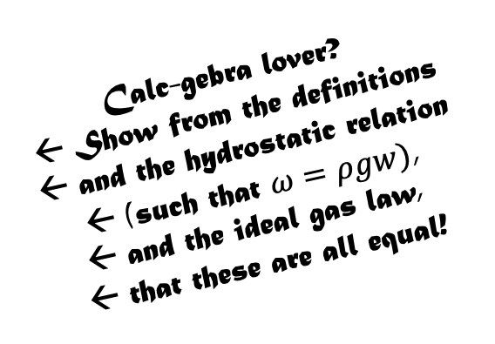
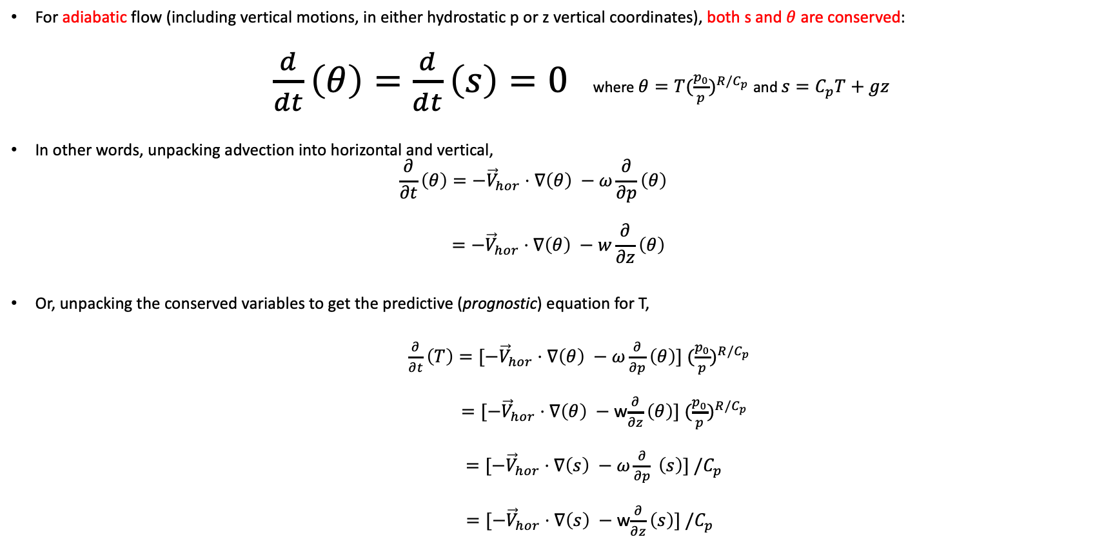
All these statements are equally true
For adiabatic flow (including vertical motions, in either hydrostatic p or z vertical coordinates), both s and $θ$are conserved:
$\frac{d}{dt}\left(θ\right)=\frac{d}{dt}\left(s\right)=0$where ${θ=T(\frac{p_{0}}{p})}^{R/C_{p}}$ and $s=C_{p}T+gz$
In other words, unpacking advection into horizontal and vertical,
$$\frac{∂}{∂t}\left(θ\right)=−{\vec{V}}_{hor}⋅∇\left(θ\right) −ω\frac{∂}{∂p}\left(θ\right)$$
$$=−{\vec{V}}_{hor}⋅∇\left(θ\right) −w\frac{∂}{∂z}\left(θ\right)$$
Or, unpacking the conserved variables to get the predictive (prognostic) equation for T,
$\frac{∂}{∂t}\left(T\right)=[−{\vec{V}}_{hor}⋅∇\left(θ\right) −$ $ω\frac{∂}{∂p}\left(θ\right)] {(\frac{p_{0}}{p})}^{R/C_{p}}$
$=[−{\vec{V}}_{hor}⋅∇\left(θ\right) −$ w$\frac{∂}{∂z}\left(θ\right)] {(\frac{p_{0}}{p})}^{R/C_{p}}$
$=[−{\vec{V}}_{hor}⋅∇\left(s\right) −$ $ω\frac{∂}{∂p} \left(s\right)] /C_{p}$
$=[−{\vec{V}}_{hor}⋅∇\left(s\right) −$ w$\frac{∂}{∂z}\left(s\right)] /C_{p}$
Calc-gebra lover?
Show from the definitions
and the hydrostatic relation
(such that $ω=ρgw)$,
and the ideal gas law,
that these are all equal!

